Slide 1
Service Oriented Architecture Discussion
Modernization Through Business and Technology Transformation
Avi Bender
Director, Enterprise Architecture
Tom Lucas, Senior Advisor, EA
Department of Treasury, Internal Revenue Service

Slide 2
The IRS As A Service Oriented Organization
MISSION | Provide American taxpayers top-quality service by helping them understand and meet their tax responsibilities and by applying the tax law with integrity and fairness to all.
VISION | The IRS is an agency with the human capital and technology capabilities to effectively and efficiently collect the taxes owed with the least disruption and burden to taxpayers.
STRATEGIC GOALS | Goal #1: Improve Taxpayer Service Goal #2: Enhance Enforcement of the Tax Law Goal #3: Modernize the IRS Through its People, Processes, and Technology

Slide 3
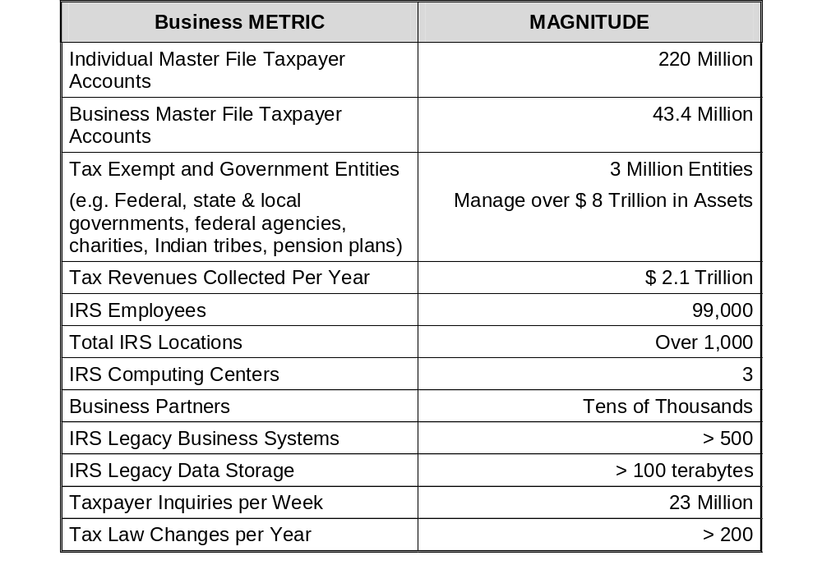
To Put Things in Perspective….

Slide 4




Tax Administration Technology Environment
The IRS Tax Administration System, which collects more than $2 trillion in revenue every year, is heavily dependent on a wide variety of over 500 computer systems, some were designed in the 1960’s.
Revenue
Accounting
Financial
Reporting
Treasury, GAO
Master
Files
Workflow, Work Management, Case Management, Pending Updates Customer Communications
Daily/
On Demand
Returns, Payments,
Correspondence
Capture
Data
From Paper
Daily/Weekly &
On Demand
Taxpayer
(Telephone & Correspondence)
Daily
Weekly
Weekly
Weekly
Submissions Processing
Paper
Validate &
Perfect
Data
Post, Settle
Accounts
Integrated Data
Retrieval
System
Customer Service Systems
Daily/
On Demand
Active Accounts
(10% max.)
Examination Systems
Taxpayer Account
Processing
(Computing Center)
Electronic
Receipt of
Submissions
Corporate Files
Online
Collection Systems
Electronic
Returns, Payments,
Correspondence
Criminal Investigation Systems
Databases with replicated & new data
Daily
Daily
Internal Management Systems
(Human Resources, Internal Financial Management, Records Management, etc.)
Limitations inherent in these systems have created complexity and overhead

Slide 5
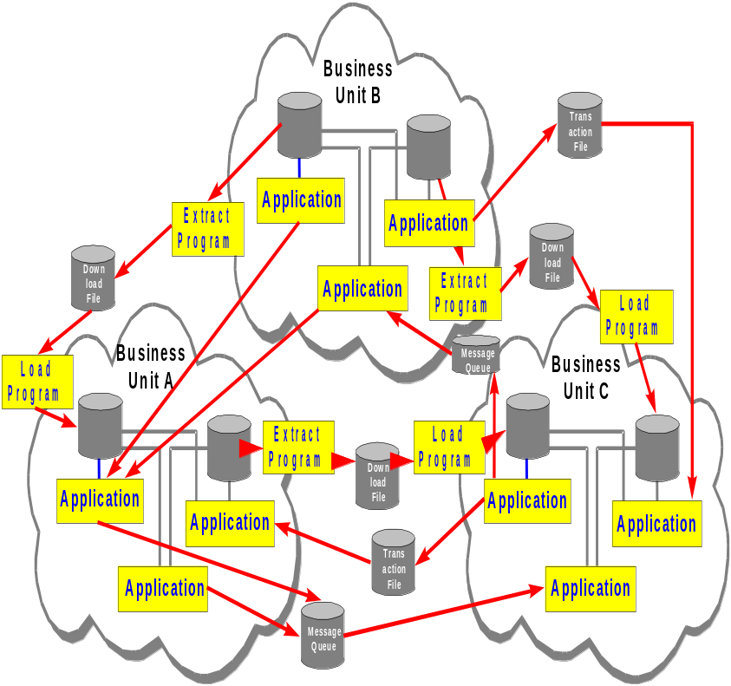
SOA Why “Modernize”?
Legacy of Point to Point Solutions
Point to point integration is much more difficult to maintain
Lots of custom software development
Difficult to share and collaborate
Too many proprietary systems and related training and maintenance
Hard coding makes it difficult to change/add/remove, and Retire
Inflexibility to address new technology and business directives
Can’t readily support process level integration

Slide 6
Key IRS Business Drivers & Challenges Impact Tax Administration
Business Requirements | IRS Context
Simplification | Reduce the complexity of existing systems by decomposing into common services Reduce the amount of custom code
Service Reuse | Leverage common application and infrastructure services to achieve operational efficiencies, and cost savings Lower costs required to maintain complex systems to free capital for value added capabilities Enable modernized applications to leverage CPE based services
Agility | Create a business and technology architecture that can support changing regulatory, business and customer needs Unlock the power of data for transformation of the business Create a flexible architecture that is aligned with MV&S
Enable Transformation | Establish a phased modernization (Transformation) that leverages both legacy and new technologies Proactively blur the legacy and modernization boundaries through enterprise common services Reduce time to market
Regulatory Requirements | Federal Enterprise Architecture Service Reference Model Treasury Enterprise Architecture Service Reference Model OMB EA Assessments, Clinger Cohen Act, Federal Transition Framework
Security Requirements | GAO Oversight Findings on Security Establish Common Security Services Reduce Complexity of Security Solutions

Slide 7
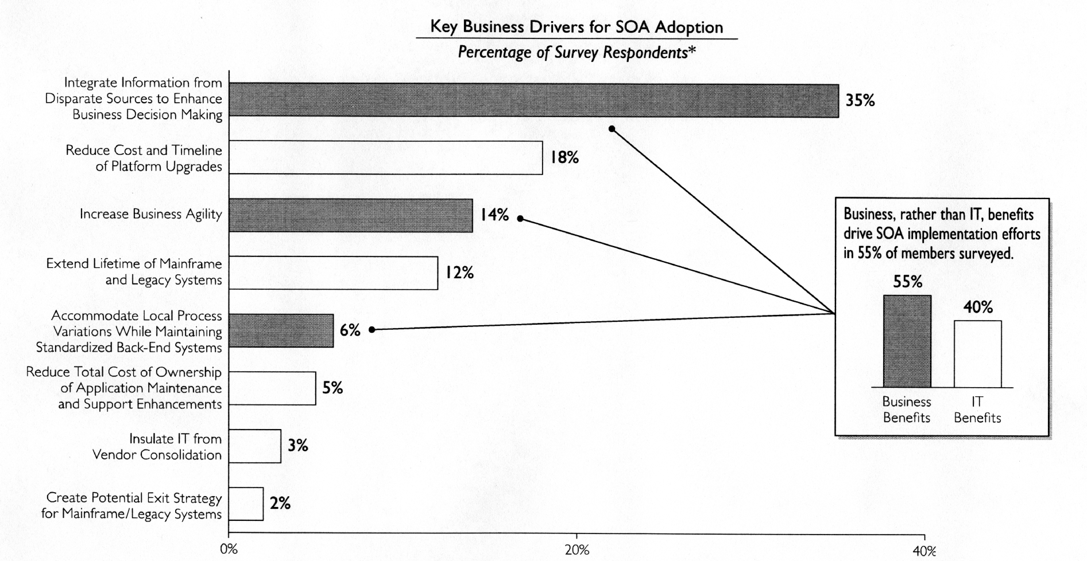

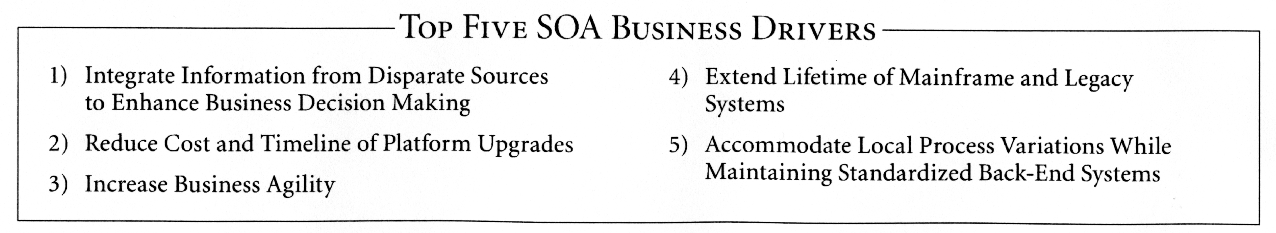
IRS Mission Drivers for SOA Adoption Are the Same as Private Industry and Other Agencies.
Transformation vs. Rip-n-Replace
Source: Executive Board, 2006

Slide 8
Four Pillars of Modernization:
Modernized E-File, CADE, Account Management Services & Data Strategy
Electronic filing to a majority of return types and payments, reducing taxpayer burden by improving quality, efficiency and service delivery
Expanded options for electronic filing, payment, communication services, and other automated services
Data capture and up-front issue detection and resolution
Improve data quality to enable business to make “data”-based decisions
Consolidate redundant data repositories
Expose and enforce common data standards to a wider audience
Reduce point-to-point transfers
Treasury, GAO
Revenue
Accounting
Financial
Reporting
Daily/
On Demand
Workflow, Work Management, Case Management, Pending Updates Customer Communications
Capture
Data
From Paper
Data Strategy
Taxpayer
(Telephone & Correspondence)
Returns, Payments,
Correspondence
Modernized E-File
Taxpayers
Customer Service Systems
Submissions Processing
Paper
Daily
Validate &
Perfect
Data
Examination Systems
Daily/
On Demand
Taxpayer
Accounts
Taxpayer
(Telephone & Correspondence)
Electronic
Receipt of
Submissions
Customer Account
Data Engine
(CADE)
Tax
Returns
Account
Management
Services
Collection Systems
Electronic
Returns, Payments,
Correspondence
Case /
Activity
History
Criminal Investigation Systems
Daily
On-line tools to view and update taxpayer data (adjustments, transfer money, apply credits, and do other updates to taxpayer accounts)
Record activity history
Monitor account for follow-up activity
Compose and print notices
Generate notices
Post Transactions (tax assessments, payments, interest, penalty, extensions, bankruptcy, address changes, etc.)
Issue refunds
Identify account issues
Generate notices
Financial balance and controls
Daily

Slide 9
What is SOA?
SOA is a services driven design approach that integrates business and IT strategies to provide Common Services that leverage existing and new functionality
The strategy of SOA includes:
    Integration with IRS strategic Planning (MV&S)
    Providing modernization through the sharing & reuse of services across the enterprise
    Streamlines existing business processes for greater efficiency and productivity
The approach for SOA:
    Leverage existing IT investments and open standards
    Connect applications and data to deliver connectivity and interoperability
    Reduce redundancy in functionality and data stores
Development using SOA:
    Shifts the focus from writing and rewriting code to application and service assembly
    Promotes the use of consistent design patterns and tools across development efforts
Standards allow applications to be designed for reuse
    Components that can be used over and over again
    Standardized interfaces and standard data definitions
    Business logic is separated from the infrastructure

Slide 10
Modernization Vision and Strategy:
Partnership Organized Around Functional Business Segments – Not Organizations
Submission
Processing
Customer Service
Manage Taxpayer
Accounts
Reporting
Compliance
Filing & Payment
Compliance
Criminal
Investigation
Internal
Management
Other Functional
Domains
Submission
Processing
Customer Service
Manage Taxpayer
Accounts
Reporting
Compliance
Filing & Payment
Compliance
Criminal
Investigation
Internal
Management
Other Functional
Domains
Business Organizations
Define the IRS business
units impacted by the modernization effort
Business Domains
Define the frontline tax administration functions that are within the scope of the new MV&S
Submission
Processing
Customer Service
Manage Taxpayer
Accounts
Reporting
Compliance
Filing & Payment
Compliance
Criminal
Investigation
Internal
Management
Other Functional
Domains
MITS
Submission
Processing
Customer Service
Manage Taxpayer
Accounts
Reporting
Compliance
Filing & Payment
Compliance
Criminal
Investigation
Internal
Management
Other Functional
Domains
Submission
Processing
Customer Service
Manage Taxpayer
Accounts
Reporting
Compliance
Filing & Payment
Compliance
Criminal
Investigation
Internal
Management
Other Functional
Domains
Submission
Processing
Customer Service
Manage Taxpayer
Accounts
Reporting
Compliance
Filing & Payment
Compliance
Criminal
Investigation
Internal
Management
Other Functional
Domains
Internal Management
Submission
Processing
Customer Service
Manage Taxpayer
Accounts
Reporting
Compliance
Filing & Payment
Compliance
Criminal
Investigation
Internal
Management
Other Functional
Domains
Criminal Investigation
Large & Mid Sized Business
Tax Exempt/Government Entity
Wage and Investment
Small Business/Self Employed
Service Domains
Define the services necessary to support the effective and secure execution of the core mission-critical business functions
Cut across multiple domains
Common Business Services
Data Access & Update Services
Infrastructure Services
Common Security Services

Slide 11
The IRS SOA Framework is Based Upon Three Core Areas: Common Services, Platform and Tooling, and Governance
Common Services
Enterprise Business Services
Business units of work resulting from broad based decomposition
Security Services
Application Services
Application integration / shared services
(ESB/EAI Enabled)
Data
Governance
Infrastructure Services
Hardware utility functions and solutions
Platform & Tooling
SOA enabling
Technology
(middleware)
Current Activities
There are different types of services, that provide different types of value to the IRS
All require governance and specialized platform & tooling
The IRS has initially focused on building out Infrastructure and Application Services, and will advance to Enterprise Business Services (higher value) as SOA maturity increases
Notes:
SOA is a business driven process and approach
There are three anchor points: Common services, Platform & Tooling, and Governance
Common Services, whether we are talking about business, application, data, infrastructure, … are at the core of SOA
Most of our work to-date has been around MV&S & early stages of Common Services, not yet data services (Data Services), Infrastructure services (link to the IRI)
Just starting with the enterprise services (decomposing the existing the CPE systems i.e. IDRS…)

Slide 12
Evolution of IRS Common Business Services Portfolio
SOA Tooling, Governance and
Growing Portfolio Of Services
MV&S Portfolio
Core Account Management Services (AMS), Infrastructure and Security Services
Candidate Business Services:
Case Management
Interaction Management
Return Retrieval
Notice Services
Entity Management
Candidate IT Services:
(over 120 candidate services have been identified, but not yet filtered)
Calculate Payoff Amount
Create Activity History Record
Create Document Entry
Get Activity History Record
Get Disclosure Information
Get Entity Information
Get PowerOfAttorney
Get Refund Inquiry Data
Get Reporting Agent File
Get Social Security Data
Get Taxpayer Information File (3)
Get Taxpayer Summary
Retrieve Document Instance
Retrieve Document List
Retrieve workflow case current state
Update Taxpayer Address
Initiate Workflow Case
Security Services
  Audit Trail
  Encryption
  Identity Management
Infrastructure Services
  Message Routing
  Data Transformation
  Storage for DR
Filing & Payment Compliance (F&PC)
MeF Prototype & Initial Web Services
SOA Platform & Planning
Assign case
Get PowerOfAttorney
Get Taxpayer Address of Record
Unassigned Case
Update Case Component Assignment
Acquisition of EAI, middleware SOA Roadmap
Modernized e-File Web Services
Prototype Web Services Architecture
Get Submission
Send State Return
2005
2006
2007
2008
2009

Slide 13
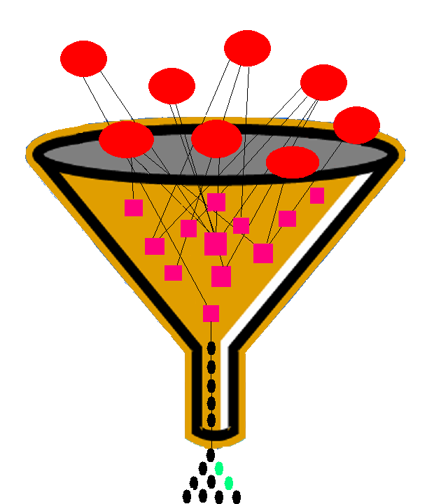
Common Services Are Business Driven by MV&S (Strategic Planning and Investments) and Filtered Through an Evolving Common Services Framework
SIRS
EDSS
TPOT
ETEC
Plan
(MV&S)
MV&S promotes a business perspective around potential shared services
Service orientation drives efficiencies and reuse across the Enterprise
The Common Services Framework will be refined based on lessons learned from MV&S and initial services deployments
IMS
TREES
AMS
MeF
Common Services Framework
Define, Design,
Build, Deploy
Candidate Services
Retrieve Tax Return Data (Raw XML)
O&M
Retrieve Transformed Tax Return (PDF)

Slide 14
As Our SOA Strategy Matures We Will Transition From Opportunistic, Project Level, to Enterprise Level Common Business Services
Enterprise
Infrastructure
Storage/DR
Security
Identity Management
High
Return
Retrieval
Tax
Computation
Case
Assignment
Case
Folder
Scope
Account Management Services
Taxpayer Account Data Services
Individual Customer Account Services (ICAS)
Integration
Assign PDC Case
Legacy Access Provider (LAP) Services
Send Submission
Send State Submission
Get Address Of Record
Low
Opportunistic
IRS Acknowledgement
Low
Time/Maturity
High

Slide 15
Common Services Identification and Deployment Require a Broad Based IRS Governance Process
Starts with MV&S business process requirements
Impacts People, Process & Technology
Services are Delivered Through Projects
Life Cycle Processes are supported by Services Repository
Development of Services is Guided by IRS Enterprise Life Cycle (ELC)
Communication & Training are required for people supporting each of the enterprise processes in the lifecycle.
Measure
Use/Reuse
Service
Iterative Common Services
Life Cycle
Operate /
Monitor
Service
Requirements
Deploy
Service
Service Repository
Architectural
review
GOVERNANCE
Test
service
Design
service
Construct
service
Governance Organization – Manage & monitor service agreements
Governance Tooling – Not like traditional software development

Slide 16
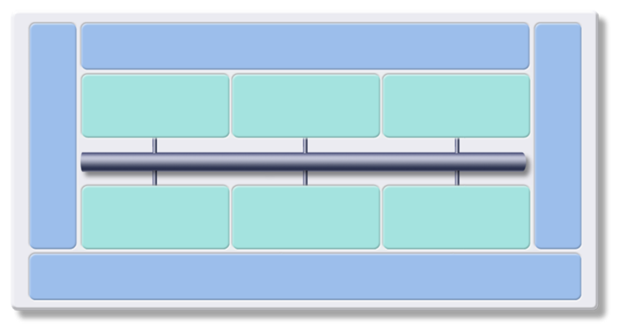
SOA Platform & Tooling Architectural View – Backbone of a Future Distributed and Interoperable Computing Environment
Current Implementation State, Gaps Exist That Will Need to be Filled
Business Innovation & Optimization Services
Presentation & Portal Services
Business Process Services
Information Management Services
Development & Test Services
IT Service
Management
ESB Topology
Application Services
Integration & Broker Services
Partner Services
Data, Infrastructure and Security Services
Notes:
**Main point: The SOA reference architecture is a vendor-neutral way of looking at and planning the set of services that go into building an SOA.
The SOA Reference Architecture is a way of looking at the set of services that go into building an SOA. This architecture is not unique to IBM; these are things that you need to consider when approaching SOA regardless of what products and services are used. These capabilities can be implemented on a build-as-you-go basis allowing capabilities and project level solutions to be easily added as new requirements are addressed over time. You can see that these services organized along the same lifecycle we’ve discussed. On the left in is Development Services which is model and assemble, in the middle are the elements of the deployment run-time environment you use and on the right is management. The backbone of the reference architecture is the enterprise service bus which facilitates communication between services. The reference architecture is a great tool for laying out roadmaps for pursuing SOA. Regardless of what kind of project you’re undertaking, it makes sense to lay it out on a reference architecture to see how the various services you’re designing are going to interact with each other
Additional detail:
The SOA Reference Architecture outlines the key capabilities that are required for comprehensive, enterprise wide SOA solutions. These capabilities can be implemented on a build-as-you-go basis allowing capabilities and project level solutions to be easily added as new requirements are addressed over time.
Development Services are an essential component of any comprehensive integration architecture. The SOA Architecture includes development tools, used to implement custom artifacts that leverage the infrastructure capabilities, and business performance management tools, used to monitor and manage the runtime implementations at both the IT and business process levels. Development tools allow people to efficiently complete specific tasks and create specific output based on their skills, their expertise, and their role within the enterprise. Business Analysts who analyze business process requirements need modeling tools that allow business processes to be charted and simulated. Software Architects need tool perspectives that allow them to model data, functional flows, system interactions, etc. Integration Specialists require capabilities that allow them to configure specific inter-connections in the integration solution. Programmers need tools that allow them to develop new business logic with little concern for the underlying platform. Yet, while it is important for each person to have a specific set of tool functions based on their role in the enterprise, the tooling environment must provide a framework that promotes joint development, asset management and deep collaboration among all these people. A common repository and functions common across all the developer perspectives (e.g. version control functions, project management functions, etc) are provided in the SOA Reference Architecture through a unified development platform.
The Business Innovation & Optimization Services incorporate monitoring capabilities that aggregate operational and process metrics in order to efficiently manage systems and processes. Managing these systems requires a set of capabilities that span the needs of IT operations professionals and business analysts who manage the business operations of the enterprise. These capabilities are delivered through a set of comprehensive services that collect and present both IT and process-level data, allowing business dashboards, administrative dashboards, and other IT level displays to be used to manage system resources and business processes. Through these displays and services, it is possible for LOB and IT personnel to collaborate to determine, for example, what business process paths may not be performing at maximum efficiency, the impact of system problems on specific processes, or the relationship of system performance to business process performance. This collaboration allows IT personnel and assets to be tied more directly to the business success of the enterprise than they traditionally have been.
One key feature of the SOA Reference Architecture is the linkage between the Development and the Business Innovation & Optimization Services. The ability to deliver runtime data and statistics into the development environment allows analyses to be completed that drive iterative process re-engineering through a continuous business process improvement cycle.
At the core of the SOA Reference Architecture is the Enterprise Service Bus. This architectural construct delivers all the inter-connectivity capabilities required to leverage and use services implemented across the entire architecture. Transport services, event services, and mediation services are all provided through the ESB. Transport services provide the fundamental connection layer; event services allow the system to respond to specific stimuli that are part of a business process; and mediation services allow loose-coupling between interacting services in the system. The ESB is a key factor in enabling the service orientation of the SOA Reference Architecture to be leveraged in implementing service oriented solutions and can be implemented today to meet the quality of service requirements of any integration solution.
The SOA Reference Architecture also contains a set of services that are oriented toward the integration of people, processes, and information. These services control the flow of interactions and data among people and automated application services in ways appropriate to the realization of a business process:
- Interaction Services provide the capabilities required to deliver IT functions and data to end users, meeting the end-user's specific usage preferences.
- Process Services provide the control services required to manage the flow and interactions of multiple services in ways that implement business processes.
- Information Services provide the capabilities required to federate, replicate, and transform data sources that may be implemented in a variety of ways.
Automated application services, implementations of business logic in automated systems, are a critical part of any integration architecture or solution. Many of these services are provided through existing applications; others are provided in newly implemented components; and others are provided through external connections to third party systems. Existing enterprise applications and enterprise data are accessible from the ESB through a set of access services. These Access Services provide the bridging capabilities between legacy applications, pre-packaged applications, enterprise data stores (including relational, hierarchical and nontraditional, unstructured sources such as XML and Text), etc and the ESB. Using a consistent approach, these access services expose the data and functions of the existing enterprise applications, allowing them to be fully re-used and incorporated into functional flows that represent business processes. Existing enterprise applications and data leverage the Business Application and Data Services of their operating environments such as CICS, IMS, DB2, etc. As these applications and data implementations evolve to become more flexible participants in business processes, enhanced capabilities of their underlying operating environments, for example support of emerging standards, can be fully utilized.
The SOA Reference Architecture also contains a set of Business Application Services that provide runtime services required for new application components to be included in the integrated system. These application components provide new business logic required to adapt existing business processes to meet changing competitive and customer demands of the enterprise. Design and implementation of new business logic components for integration enables them to be fully re-useable, allowing them to participate in new and updated business processes over time. The Business Application Services include functions important to the traditional programmer for building maintainable, flexible, and re-useable business logic components.
In many enterprise scenarios, business processes involve inter-actions with outside partners and suppliers. Integrating the systems of the partners and suppliers with those of the enterprise improves efficiency of the overall value chain. Partner Services provide the document, protocol, and partner management services required for efficient implementation of business-to-business processes and inter-actions.
Underlying all these capabilities of the SOA Reference Architecture is a set of Infrastructure Services which provide security, directory, IT system management, and virtualization functions. The security and directory services include functions involving authentication and authorizations required for implementing, for example, single sign-on capabilities across a distributed and heterogeneous system.
IT Services Management Services include functions that relate to scale and performance, for example edge services and clustering services, and the virtualization capabilities allow efficient use of computing resources based on load patterns, etc. The ability to leverage grids and grid computing are also included in infrastructural services.
While many of the Infrastructure and IT Service Management services perform functions tied directly to hardware or system implementations, others provide functions that interact directly with integration services provided in other elements of the architecture through the ESB. These interactions typically involve services related to security, directory, and I/T operational systems management.
The SOA Reference Architecture is a complete and comprehensive architecture that covers all the integration needs of an enterprise. Its services are well integrated and are delivered in a modular way, allowing SOA implementations to start at a small project level. As each additional project is addressed, new functions can be easily added, incrementally enhancing the scope of integration across the enterprise. In addition to supporting SOA strategies and solutions, the architecture itself is designed using principles of service orientation and function isolation.

Slide 17
SOA Platform & Tooling Architectural View – Categories
Current Implementation State, Gaps Exist That Will Need to be Filled
Business Activity
Monitoring (BAM)
Developer
Tools
ESM
Tools
Developer
Lang.
Business Innovation & Optimization Services
BPM
Portal Tools
& Server
Bus Rules
Engine
Document
Mgmt
Data Tools
Analytics
Content Mgmt
Workflow
Choreography
XML Rep.
Metadata Rep.
IT Service
Management
Development
& Test Services
Service Reg.
Presentation & Portal Services
Business Process Services
Information Management Services
Routing
Transformation
Orchestration
Service
Mgmt
ESB Topology
B2G
C2G
Custom Apps
Test
Tools
G2G
Custom Apps
Packaged Apps
Custom Apps
Packaged Aps
Service
Broker
Web App
Server
Mediation
Adaptors
SLA
Mgmt
Partner Services
Application Services
Integration & Broker Services
Access
Control
Enterprise Message
Queue
Identification &
Authentication
Audit
Directory
PKI
Infrastructure and Security Services
Legend:
Existing
In Progress
Known Gaps
Notes:
**Main point: The SOA reference architecture is a vendor-neutral way of looking at and planning the set of services that go into building an SOA.
The SOA Reference Architecture is a way of looking at the set of services that go into building an SOA. This architecture is not unique to IBM; these are things that you need to consider when approaching SOA regardless of what products and services are used. These capabilities can be implemented on a build-as-you-go basis allowing capabilities and project level solutions to be easily added as new requirements are addressed over time. You can see that these services organized along the same lifecycle we’ve discussed. On the left in is Development Services which is model and assemble, in the middle are the elements of the deployment run-time environment you use and on the right is management. The backbone of the reference architecture is the enterprise service bus which facilitates communication between services. The reference architecture is a great tool for laying out roadmaps for pursuing SOA. Regardless of what kind of project you’re undertaking, it makes sense to lay it out on a reference architecture to see how the various services you’re designing are going to interact with each other
Additional detail:
The SOA Reference Architecture outlines the key capabilities that are required for comprehensive, enterprise wide SOA solutions. These capabilities can be implemented on a build-as-you-go basis allowing capabilities and project level solutions to be easily added as new requirements are addressed over time.
Development Services are an essential component of any comprehensive integration architecture. The SOA Architecture includes development tools, used to implement custom artifacts that leverage the infrastructure capabilities, and business performance management tools, used to monitor and manage the runtime implementations at both the IT and business process levels. Development tools allow people to efficiently complete specific tasks and create specific output based on their skills, their expertise, and their role within the enterprise. Business Analysts who analyze business process requirements need modeling tools that allow business processes to be charted and simulated. Software Architects need tool perspectives that allow them to model data, functional flows, system interactions, etc. Integration Specialists require capabilities that allow them to configure specific inter-connections in the integration solution. Programmers need tools that allow them to develop new business logic with little concern for the underlying platform. Yet, while it is important for each person to have a specific set of tool functions based on their role in the enterprise, the tooling environment must provide a framework that promotes joint development, asset management and deep collaboration among all these people. A common repository and functions common across all the developer perspectives (e.g. version control functions, project management functions, etc) are provided in the SOA Reference Architecture through a unified development platform.
The Business Innovation & Optimization Services incorporate monitoring capabilities that aggregate operational and process metrics in order to efficiently manage systems and processes. Managing these systems requires a set of capabilities that span the needs of IT operations professionals and business analysts who manage the business operations of the enterprise. These capabilities are delivered through a set of comprehensive services that collect and present both IT and process-level data, allowing business dashboards, administrative dashboards, and other IT level displays to be used to manage system resources and business processes. Through these displays and services, it is possible for LOB and IT personnel to collaborate to determine, for example, what business process paths may not be performing at maximum efficiency, the impact of system problems on specific processes, or the relationship of system performance to business process performance. This collaboration allows IT personnel and assets to be tied more directly to the business success of the enterprise than they traditionally have been.
One key feature of the SOA Reference Architecture is the linkage between the Development and the Business Innovation & Optimization Services. The ability to deliver runtime data and statistics into the development environment allows analyses to be completed that drive iterative process re-engineering through a continuous business process improvement cycle.
At the core of the SOA Reference Architecture is the Enterprise Service Bus. This architectural construct delivers all the inter-connectivity capabilities required to leverage and use services implemented across the entire architecture. Transport services, event services, and mediation services are all provided through the ESB. Transport services provide the fundamental connection layer; event services allow the system to respond to specific stimuli that are part of a business process; and mediation services allow loose-coupling between interacting services in the system. The ESB is a key factor in enabling the service orientation of the SOA Reference Architecture to be leveraged in implementing service oriented solutions and can be implemented today to meet the quality of service requirements of any integration solution.
The SOA Reference Architecture also contains a set of services that are oriented toward the integration of people, processes, and information. These services control the flow of interactions and data among people and automated application services in ways appropriate to the realization of a business process:
- Interaction Services provide the capabilities required to deliver IT functions and data to end users, meeting the end-user's specific usage preferences.
- Process Services provide the control services required to manage the flow and interactions of multiple services in ways that implement business processes.
- Information Services provide the capabilities required to federate, replicate, and transform data sources that may be implemented in a variety of ways.
Automated application services, implementations of business logic in automated systems, are a critical part of any integration architecture or solution. Many of these services are provided through existing applications; others are provided in newly implemented components; and others are provided through external connections to third party systems. Existing enterprise applications and enterprise data are accessible from the ESB through a set of access services. These Access Services provide the bridging capabilities between legacy applications, pre-packaged applications, enterprise data stores (including relational, hierarchical and nontraditional, unstructured sources such as XML and Text), etc and the ESB. Using a consistent approach, these access services expose the data and functions of the existing enterprise applications, allowing them to be fully re-used and incorporated into functional flows that represent business processes. Existing enterprise applications and data leverage the Business Application and Data Services of their operating environments such as CICS, IMS, DB2, etc. As these applications and data implementations evolve to become more flexible participants in business processes, enhanced capabilities of their underlying operating environments, for example support of emerging standards, can be fully utilized.
The SOA Reference Architecture also contains a set of Business Application Services that provide runtime services required for new application components to be included in the integrated system. These application components provide new business logic required to adapt existing business processes to meet changing competitive and customer demands of the enterprise. Design and implementation of new business logic components for integration enables them to be fully re-useable, allowing them to participate in new and updated business processes over time. The Business Application Services include functions important to the traditional programmer for building maintainable, flexible, and re-useable business logic components.
In many enterprise scenarios, business processes involve inter-actions with outside partners and suppliers. Integrating the systems of the partners and suppliers with those of the enterprise improves efficiency of the overall value chain. Partner Services provide the document, protocol, and partner management services required for efficient implementation of business-to-business processes and inter-actions.
Underlying all these capabilities of the SOA Reference Architecture is a set of Infrastructure Services which provide security, directory, IT system management, and virtualization functions. The security and directory services include functions involving authentication and authorizations required for implementing, for example, single sign-on capabilities across a distributed and heterogeneous system.
IT Services Management Services include functions that relate to scale and performance, for example edge services and clustering services, and the virtualization capabilities allow efficient use of computing resources based on load patterns, etc. The ability to leverage grids and grid computing are also included in infrastructural services.
While many of the Infrastructure and IT Service Management services perform functions tied directly to hardware or system implementations, others provide functions that interact directly with integration services provided in other elements of the architecture through the ESB. These interactions typically involve services related to security, directory, and I/T operational systems management.
The SOA Reference Architecture is a complete and comprehensive architecture that covers all the integration needs of an enterprise. Its services are well integrated and are delivered in a modular way, allowing SOA implementations to start at a small project level. As each additional project is addressed, new functions can be easily added, incrementally enhancing the scope of integration across the enterprise. In addition to supporting SOA strategies and solutions, the architecture itself is designed using principles of service orientation and function isolation.

Slide 18
SOA Road Map Implementation Strategy: Maturity Timeline
Transformation occurs in phases over the next five+ years
Each phase increases scope of adoption and process maturity
Progress occurs through projects
SOA deployments will be in waves that integrate services, portal and data strategies
Timeline
2006
2007
2008
2009
2010
2011
Phase
1 - Adoption
2 - Integration
3 - Enterprise
4 - Optimized
Scope of SOA Adoption
Project-centric, Opportunistic
Domain-wide, Strategic
Enterprise
Business Transformation
Maturity Level
Repeatable
Formally Defined
Managed
Optimized
Key
Capabilities
MeF, F&PC
AMS, CADE
All Projects in Release Plan

Slide 19
In Summary
Sell the business value of SOA- not SOA
Start with process decomposition to identify common services
Demonstrate success incrementally with a focus on high visibility lower risk
You need exceptional technical talent who have been there and done that
Focus your activities around common services, governance, and platform and tooling- leverage what you have
Weave SOA into the fabric of your enterprise lifecycle management systems
Take a non intrusive and politically astute approach………..
Good Luck and Thank You.

